Slide 1
Superstore Sales
Analysis

Slide 2
Background
With growing demands and cut-throat competitions in the market, a Superstore Giant in the US is seeking our knowledge in understanding what works best for them in terms of profitability and sales.
About the data:
Spans around 4 years
Sales totalling at $2.3M and a profit of $286K
1862 unique articles in their inventory which are divided into 3 categories (Office supplies, Technology, Furniture), all of which are being sold across 49 states in the US.

Slide 3
Approach
Product Analysis
Identify profitable & non-profitable products and its categories
Geographical Analysis
Identify profitable & non-profitable locations
Segment Analysis
Understanding who is buying the products
Notes:
So this is sort of my approach to try to understand the areas of profitability within the company or areas that are hindering them from making profits.
I'd like to look into 3 main areas....
1. Product
-identify which products are profitable or not profitable
-understand products categories and its sub-categories
2. Customer Segments
-understand who's buying the products
-how are segments divided and which segments are driving revenue
3. Geo analysis
-see which states or regions that are profitable or not profitable

Slide 4
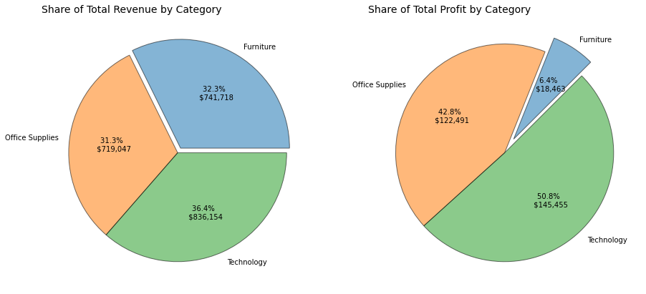
Product Analysis
12.5%
Total Profit Margin
Sales divided almost equally
Margins on Furniture is quite low in comparison to others
Notes:
Here we have an overview of our 3 main categories being sold, and the charts show the revenue and profits from each categories
- Sales are divided almost equally between product categories
- Total profit margin is 12.5%
- However, looking at each product category's share of profit, margins on Furniture is quite low in comparison to Office Supplies & Technology
(Could be due to furniture being a long time purchase, you dont buy furniture often)
- Lets take a look at sub-categories and respective margins

Slide 5
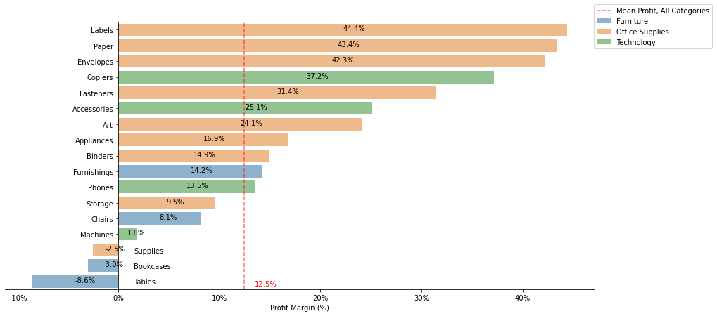
Profit Margin by Subcategory
Subcategories within Office Supplies and Technologies have a very high margin ( >2x the company’s total margin)
Profit margin on subcategories within Furniture are low
Two of Furniture’s subcategories are being sold at a loss
Notes:
Here we have all the subcategories and its profit margins
From the chart, it shows that the company has a very high margins on a few of the sub-categories (in fact more than double the company's total margin) . These sub categoeis are mainly within Office Supplies and Technology's subcategories
We can also see that profit margins on the sub-categories within Furniture are very low.
Two of the sub-categories from Furniture are even being sold at a loss.
Given this, I wanna take a look at the three subcategories and are being sold at a loss to understand the reason behind this.

Slide 6
Drop off in margins is quite big within Tables and Bookcases
Supplies actually have a very high margin on many of its items, yet the subcategory as a whole is sold at a loss
Explanation: Highest selling items are being sold at a loss, bringing the margin down for entire subcategory
Notes:
So here we have the Top sub-categories with the highest profit margins
And we can see that the drop off in margins is quite big within Tables and Bookcases. Even the 15th highest margin item within Tables is actually being sold at a loss (out of 56 of it's items).
However, we see that Supplies here surprisingly, have a very high margin on many of it's items. Yet, the sub-category as a whole is sold at a loss.
And I believe the explanation for this is that the highest selling items (most revenue and impactful on category proft) are being sold at a loss, therefore bringing the margin down for the entire sub-category.
So, there are a number of products within Supplies, who have really high sales but are being sold at a negative profit, and thats not really ideal. And to prove this…..

Slide 7
Top 5 Sales in Supplies Sub-Category
Product Name | Postal Code | Sales | Discount | Profit | Profit | Profit Margin
High Speed Automatic Electric Letter Opener | 266895 | 17030.312 | 11 | 0.2 | -262.00 | -0.02
Martin Yale Chadless Opener Electric Letter Opener | 277104 | 16656.200 | 22 | 0.6 | -1299.18 | -0.08
Compact Automatic Electric Letter Opener | 354385 | 2982.750 | 26 | 0.4 | -57.27 | -0.02
Premier Automatic Letter Opener | 195746 | 2836.366 | 14 | 0.6 | -427.86 | -0.15
Premier Electric Letter Opener | 405429 | 2641.608 | 24 | 0.6 | -0.00 | -0.0
Notes:
I took a look at some of the items in Supplies that contribute to the highest number of sales, and we find that they are being sold at a lost. So, definitely overall it brings the entire profit margin of the whole sub category down. Which is not ideal
Next, I want to look into the customer segments.

Slide 8
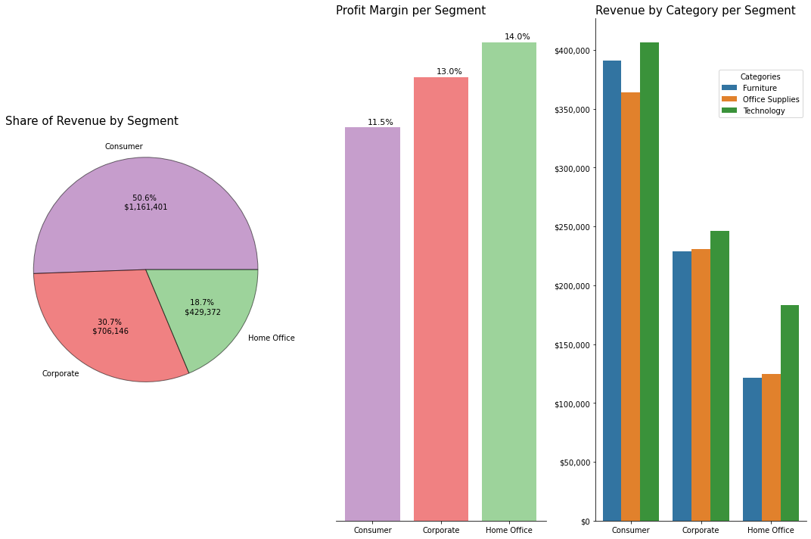
Segment Analysis
Notes:
So here we have segments of the customers, its being divided between 3 main groups which are Consumer, Corporate and Home Office.
Looking at the segments for the Superstore it is apparent that the Consumer segment is contributing the most to sales.
However, the consumer segment has a bit lower profit margin than Corporate and Home Office. This is most likely due to the high volume of sales it's doing in Furniture, which we saw before has the lowest profit margin out of all the categories of products.
Next, we can see here a distribution of the main categories across different segments.
From here, we know that most of the sales for each segment is within Technology, which on average has a high profit margin.

Slide 9
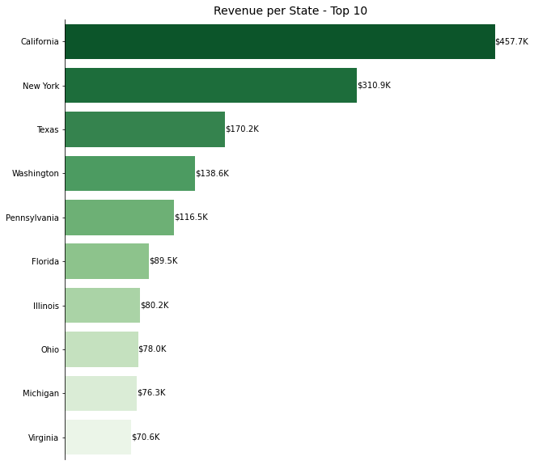
Geographical Analysis
50%
of total revenue are made in California
Drop in sales between states are quite large
80%
more sales in New York than in Texas
50%
more sales in California than in New York
Notes:
Here we have an overview of the revenue generated from top 10 states in the US.
We can clearly see that , California is sort of the dominant state. It has around 50% of the total revenue
However we also see that the drop of in sales between states is quite large as California has 50% more sales than New York (2nd highest by sales) and New York has 80% more sales than Texas (3rd highest by sales).
I believe that this company is reliant on keeping up the sales in these 3 geographical segments (out of all the 49 states they've been selling to).
And next, I want to see which states are profiting and which are not.

Slide 10
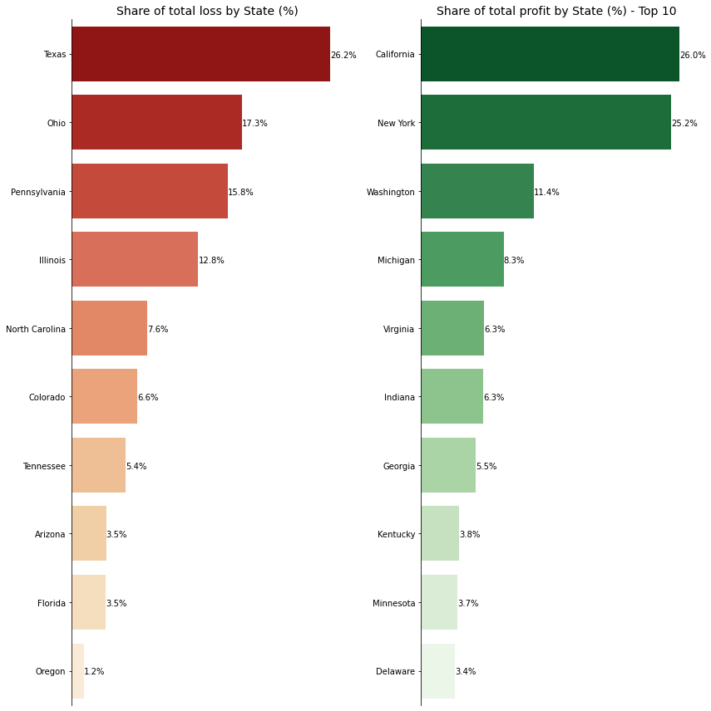
Which states are making a profit or making a loss?
Texas contributing a ¼ of the loss on profits, despite being third highest segment in terms of sales
Notes:
So here we have a chart showing which states are operating at a loss , and which states are doing fine
It's importnat we take a look at states that are on aggregate are making a loss. An important finding here is that some of the states where this company is making most of their sales is actually bringing down the profit that this company is making.
You knowTexas for instance, which is their 3rd highest segment in terms of sales, is actually contributing to more than 1/4 of the loss that the company is making on it's sales.

Slide 11
Key Takeaways
Technology & Home Office have on average a high profit margin, while Furniture are being sold at low margin or even at a loss for some of its subcategories
Consumer segment driving most of the Superstore's sales, Technology contributing most revenue across all segments
Over 50% of their profit is being made in California and New York. This makes this store quite geographically dependent on keeping up their sales here.
Their sales in Texas (which is their 3rd highest state in sales) is on aggregate making a loss.
Recommendation
Stop selling to certain states where they on aggregate are making a loss.
loss can be attributed to the types of items that are being sold to the customers in this state or that shipment costs to certain areas are driving their profits down
Stop selling non-profitable products
Customer basket analysis
Check if low or non-profit items are part of customer baskets that on aggregate are making a profit
Cost analysis
Some costs to manufacture items could be reduced to increase profit margins
Optimising supply chain process (shipment errors & processes etc.)
Notes:
#Let me explain... Imagine for instance a fast food restaurant. Let's say McDonalds. Perhaps they have low margins (or even selling at a loss) on hamburgers, while they have very high margins on fries and soda. A majority of customers will get fries and soda with their hamburger, thus on aggregate the customer basket as a whole is being sold at a profit.
From these 3 areas that we looked at, here is our key takeaways from them
Further improvements can be made, for example we could look at the competitive landscape and understand more about the competitors market share and whether or not they are profiting. Other than that, we could also monitor supply and demand for products and determine whether we should sell or not sell some of them.

